Slide 1

Analyzing Factors Influencing COVID-19 Severity and Vaccination Uptake In United states
(A CRISP-DM Approach)
602 Project Presentation
By
Krishna Teja Reddy Suram

Slide 2
Contents:
Introduction Business Understanding CRISP-DM Framework Overview Data Sources Data Understanding Data Visualization Model Building
Top Features Impacting Vaccination
Conclusion

Slide 3
Introduction
Overview: The project examines how socio-economic and demographic factors—such as age, sex, race, and vaccination data—affect COVID-19 severity and vaccination rates in the U.S.
Goal: To identify patterns in socio-economic and demographic factors that shape COVID-19 severity and vaccination uptake, providing actionable insights for public health improvements.
Key Questions:
What factors most influence vaccination uptake and case severity?
How can these findings inform targeted public health initiatives and improve healthcare equity?
Relevance:
Understanding these patterns is crucial for reducing disparities, enhancing population immunity, and preparing for future health crises.

Slide 4
Business Understanding
What socio-economic and demographic factors influence the severity of COVID-19 cases and the rates of vaccination uptake in the U.S.?
Key socio- economic and Demographic factors include:
Race & Ethnicity
Age
Gender
Relevance to COVID-19
Targeted Interventions: Identifying disparities in socio-economic and demographic factors enables the design of focused strategies to address gaps in vaccination and healthcare access.
Public Health Goals: This research supports efforts to enhance health equity by ensuring vulnerable populations receive adequate resources and interventions to reduce COVID-19 severity.

Slide 5
CRISP-DM Framework Overview
Steps in this CRISP-DM Framework:
Business Understanding: Defining the key socio-economic and demographic factors affecting COVID-19 severity and vaccination uptake.
Data Understanding: Analyzing CDC vaccination data to explore trends and relationships among age, sex, race, and vaccination metrics.
Data Preparation: Cleaning, preprocessing, and structuring the data for analysis, ensuring quality and consistency across the variables.
Modeling: Building machine learning models to identify patterns and significant factors impacting vaccination rates and case severity.
Evaluation: Assessing the model performance using metrics like accuracy and feature importance to validate insights.
Deployment: Provide actionable recommendations and visualizations to inform public health strategies and decision-making.

Slide 6
Data Sources
This Data represents all vaccine partners including jurisdictional partner clinics, retail pharmacies, long-term care facilities, dialysis centers, Federal Emergency Management Agency and Health Resources and Services Administration partner sites, and federal entity facilities.
CDC: Centers for Disease Control and Prevention - "https://data.cdc.gov/Vaccinations/COVID-19-Vaccination-Demographics-in-the-United-St/km4m-vcsb/about_data"
Coverage:
Jurisdictional partner clinics, retail pharmacies, federal entities, etc.
Key Attributes:
Demographic Categories (Age, Sex, Race/Ethnicity)
Vaccine Administration Data (e.g., administered doses, series completion, booster uptake)

Slide 7
Data Understanding
The dataframe have the following shape: Rows: 29886 and Columns: 25
Key Variables:
Date: The date the data was reported on the CDC COVID Data Tracker, representing the timeline of vaccination and case reporting.
Demographic Category: Categorizes data based on age, sex, or race/ethnicity of the person receiving the vaccination, providing insights into how different groups are affected by COVID-19 and vaccination uptake.
Administered Dose Metrics: Total count and Percentage of individuals who have received at least one dose of the COVID-19 vaccine, segmented by demographic category.
Series Completion Metrics:Total count and Percentage of individuals who have completed the primary vaccination series, a key indicator of full vaccination coverage.
Booster Metrics: Total count and Percentage of individuals who have completed the Booster , highlighting post-primary series vaccination efforts.

Slide 8
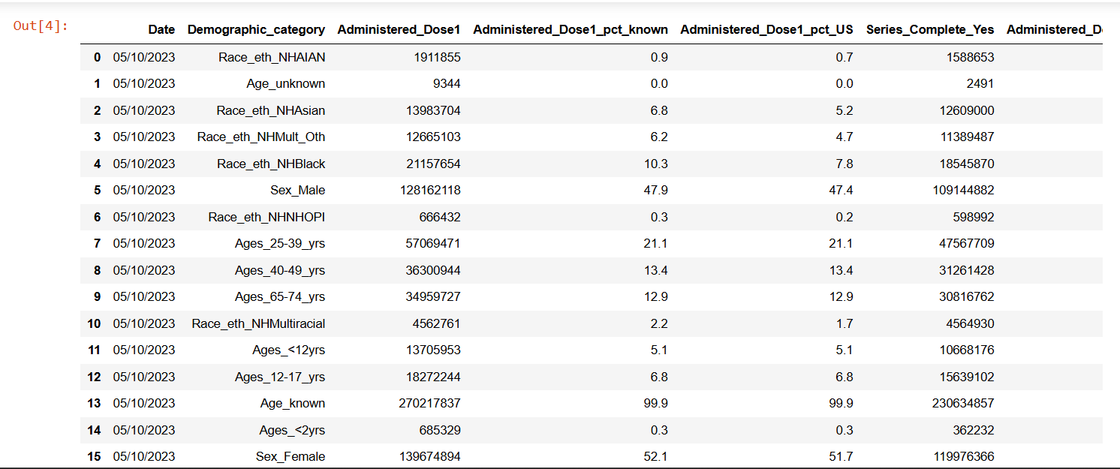
An overview of the Dataset

Slide 9
Data Understanding
The following columns are used to calculate the Total Intake of vaccinations:
Administered_Dose1
Series_Complete_Yes
Booster_Doses_Yes
Second_Booster
Bivalent_Booster
These columns represent the total counts of individuals who have received at least one dose, completed the primary series, received a booster dose, a second booster, and a bivalent booster, respectively. By summing these values, we can obtain the overall vaccination intake.

Slide 10
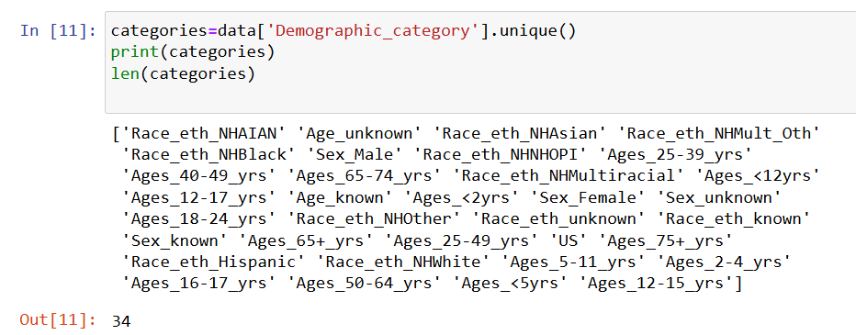
Data Understanding
The Demographic_category in the dataset consists of 34 different categories, which are based on age, sex, and race/ethnicity. These categories include:
These categories provide a detailed breakdown of vaccination data based on demographic factors like age, sex, and race, enabling a comprehensive analysis of vaccination patterns and disparities.

Slide 11
The demographic categories in the dataset can be grouped into age-based, sex-based, race/ethnicity-based, and other factors. Here's a brief overview of each:
Age-based Categories:
These categories represent different age groups to track vaccination uptake and COVID-19 severity across various stages of life. They range from infants (Ages_<2yrs) to older adults (Ages_75+_yrs), with several subcategories reflecting different age intervals, such as adolescents (Ages_12-17_yrs) and working-age adults (Ages_25-39_yrs, Ages_40-49_yrs).
Sex-based Categories:
These categories distinguish between male and female populations, as well as instances where sex is unknown or unspecified (Sex_unknown, Sex_known). Understanding differences between sexes helps identify vaccination and case severity trends based on gender.
Race/Ethnicity-based Categories:
These categories reflect the racial and ethnic diversity of the population, including non-Hispanic and Hispanic groups, as well as specific groups like Native Hawaiian or Pacific Islanders (Race_eth_NHAIAN) and Asians (Race_eth_NHAsian). These categories help explore disparities in COVID-19 severity and vaccination rates across racial and ethnic groups.
Other Categories:
These include additional factors like whether age or race/ethnicity data is known (Age_known, Race_eth_known), as well as broader geographic categories like "US" which represents the overall national data. Categories like Race_eth_unknown and Age_unknown reflect missing or unclassified data.
These demographic factors are essential for analyzing how socio-economic disparities impact COVID-19 outcomes and vaccine distribution, guiding public health interventions.

Slide 12
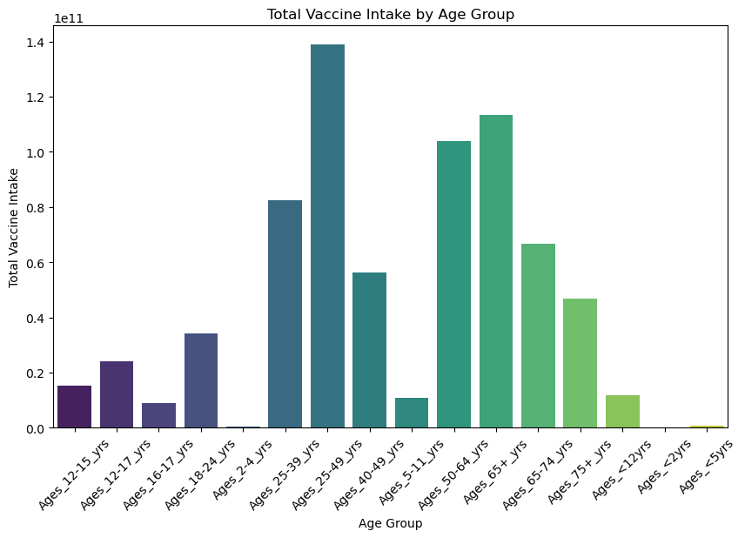
Data Visualizations
Vaccine Intake by Age Group:
The highest total vaccine intake was observed in the "25-49 years" age group, followed by "65+ years."
Children under 5 years and the "<12 years" group had significantly lower vaccine intakes compared to adults.

Slide 13
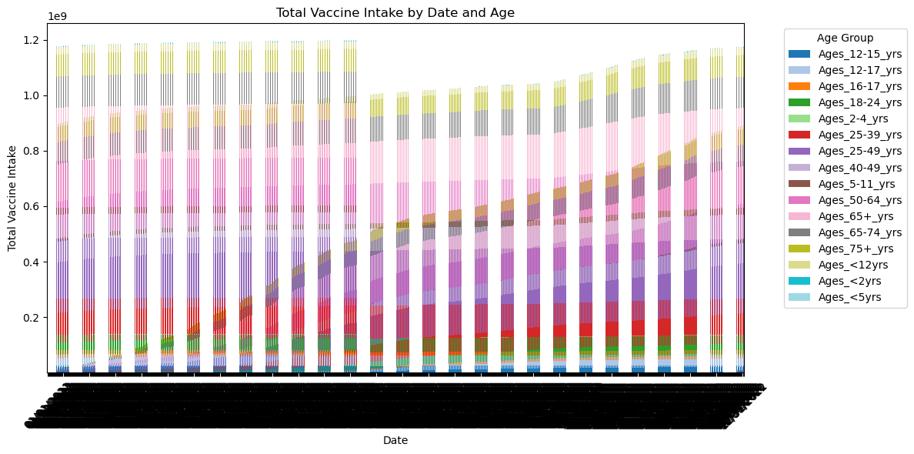
Trends Over Time by Age Group:
Across all age groups, vaccine intake increased steadily over time.
The contribution of certain age groups, such as "25-39 years" and "65+ years," is consistently higher throughout the observed period.
The distribution suggests that specific demographic groups, particularly working-age adults and the elderly, were more actively participating in vaccination efforts.

Slide 14
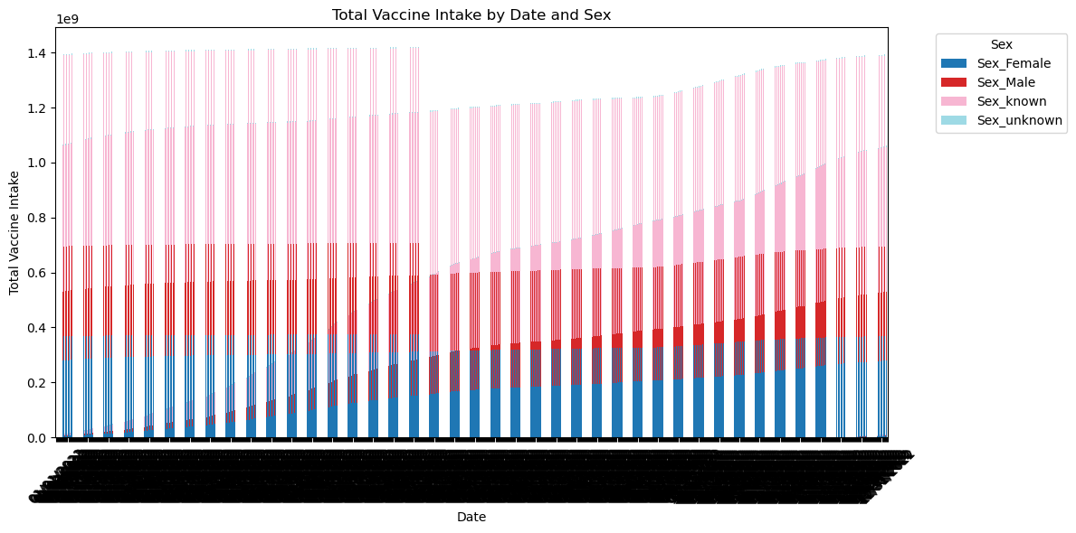
Trends Over Time by Sex:
There is a clear increase in vaccine intake over time for all genders.
Female participants seem to have slightly higher vaccine intake overall, followed by males.
Unknown or unclassified genders have a minor share of the total vaccine intake.

Slide 15
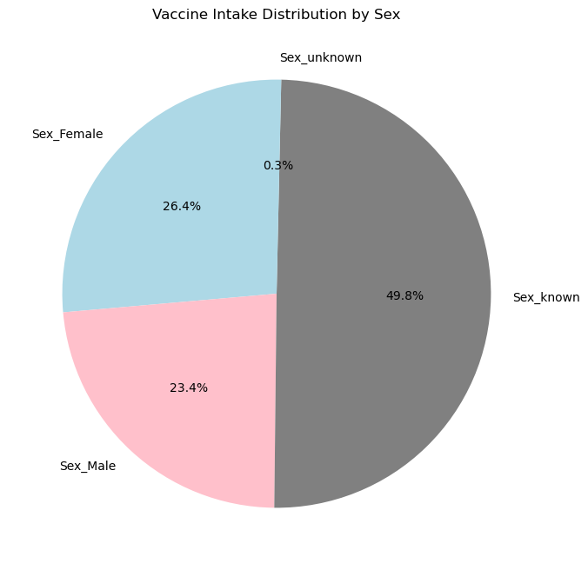
Distribution by Sex:
The pie chart reveals that nearly half (49.8%) of the vaccine intake data is categorized under "Sex_known."
Females account for 26.4%, while males represent 23.4%. This shows a near-even split between males and females, with a slight skew toward female participation.
A very small fraction (0.3%) is recorded under "Sex_unknown," indicating robust data categorization.

Slide 16
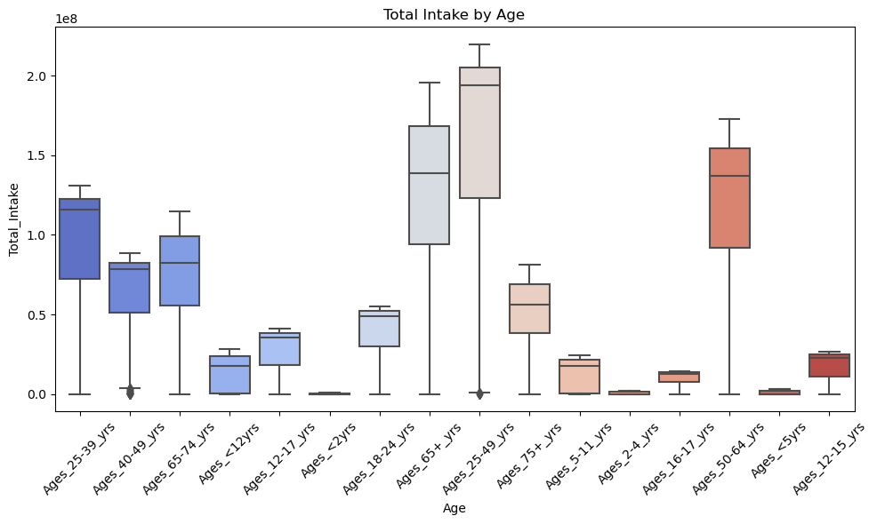
Total Intake by Age Group
Age group disparities:
The "25-49 years" group has a wide range of total vaccine intake, indicating significant variability.
Adults aged "65+ years" and "50-64 years" show consistently high vaccine uptake with lower variability compared to older populations.
The "<5 years" and "2-4 years" age groups exhibit minimal uptake, likely due to vaccination policies or eligibility issues.
Outliers:
Few outliers are present in groups like "40-49 years," suggesting occasional spikes in intake.

Slide 17
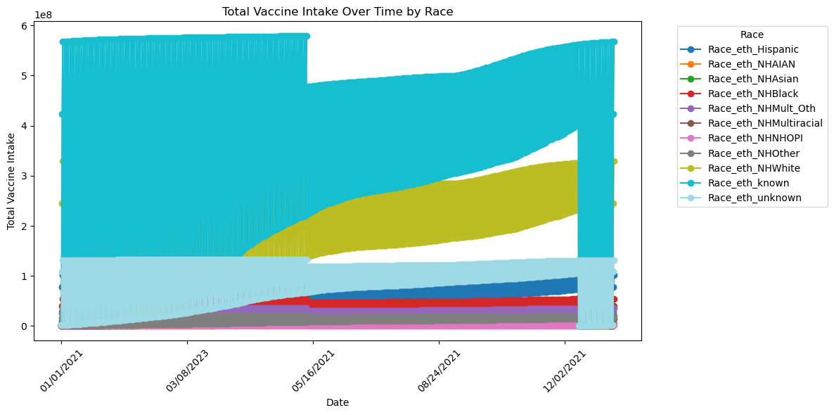
Vaccine Intake Trends by Race
Race/Ethnicity known groups:
The "Race_eth_NHWhite" (Non-Hispanic White) category dominates vaccine uptake, followed by "Race_eth_NHBlack" and "Race_eth_Hispanic."
Over time, the intake in all known racial groups increases steadily, reflecting successful vaccination campaigns.
Race/Ethnicity unknown:
The "Race_eth_unknown" category shows a notable share of vaccine data, suggesting room for improvement in demographic reporting.

Slide 18
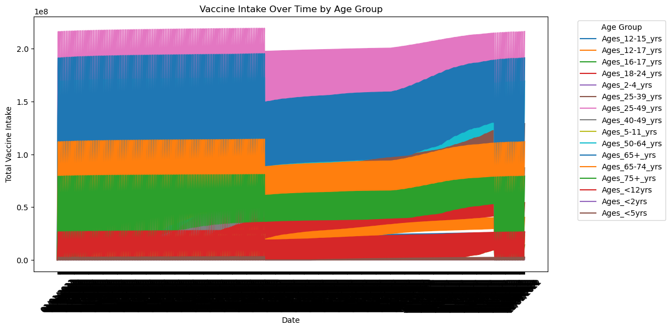
Vaccine Uptake by Age Group Over Time
Dominant contributors:
Age groups "25-39 years" and "50-64 years" consistently lead in vaccine uptake.
The "65+ years" group contributes heavily during initial vaccination rollouts but levels off over time.
Low-contributing age groups:
Children under "12 years" contribute the least throughout the timeline, likely due to staggered vaccine availability or lower prioritization.

Slide 19
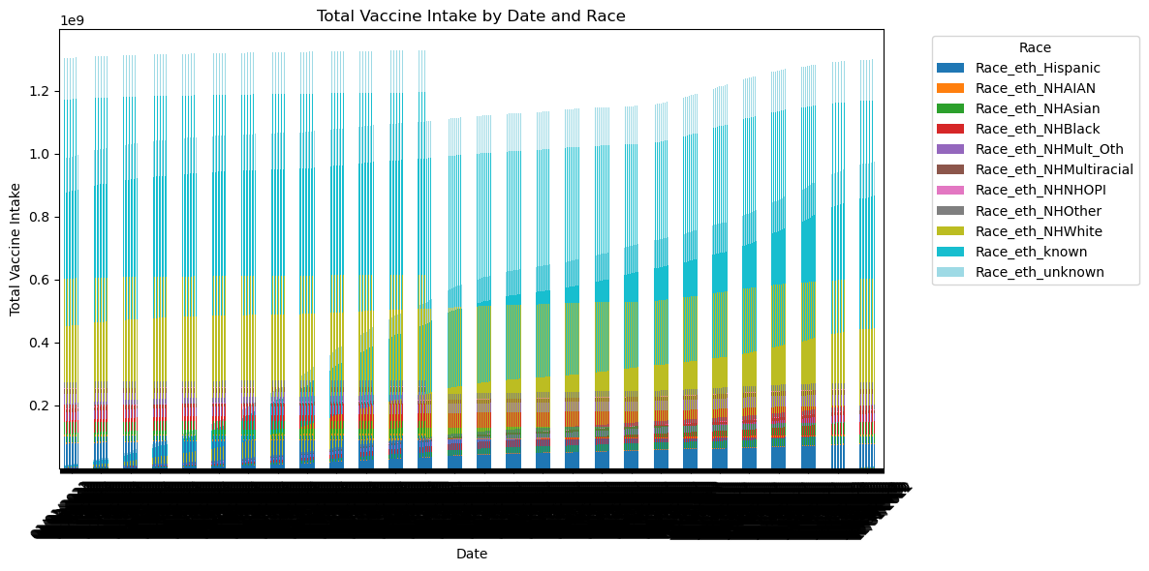
Vaccine Intake by Race Over Time
Increasing diversity:
A steady growth in vaccine intake is visible across all racial groups, demonstrating inclusive campaigns.
However, Non-Hispanic White groups maintain a disproportionate share, which may reflect disparities in access, awareness, or hesitancy among other racial/ethnic groups.
Policy implications:
Enhanced outreach efforts are needed for groups with lower uptake, such as "Race_eth_NHMultiracial" or "Race_eth_NHAsian."

Slide 20
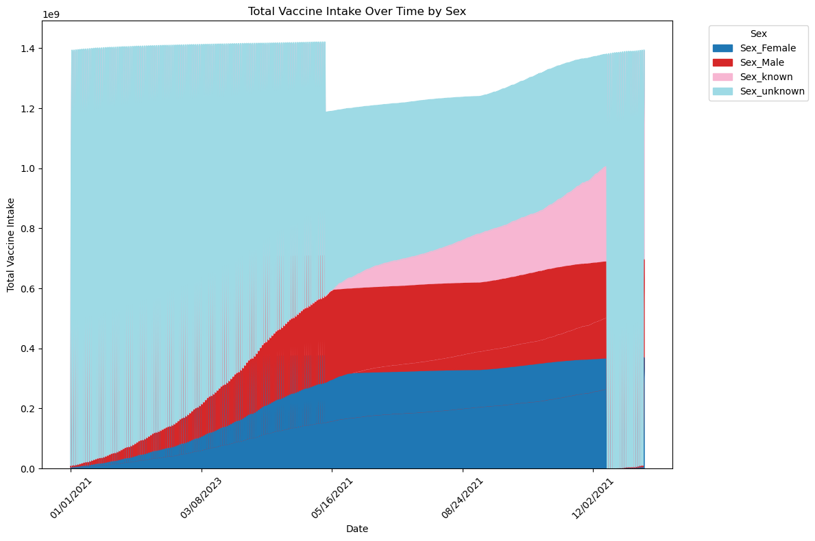
Trends Over Time by Sex
Dominance of 'Sex_known': The "Sex_known" category dominates, accounting for a significant share of vaccine intake. This category shows a steep rise over time, indicating an overall improvement in vaccine adoption.
Female and Male Participation: Females slightly outpace males in vaccine uptake, reflecting better participation or accessibility for women.
Minimal 'Sex_unknown' Contribution: The "Sex_unknown" group has minimal representation, suggesting effective data categorization.

Slide 21
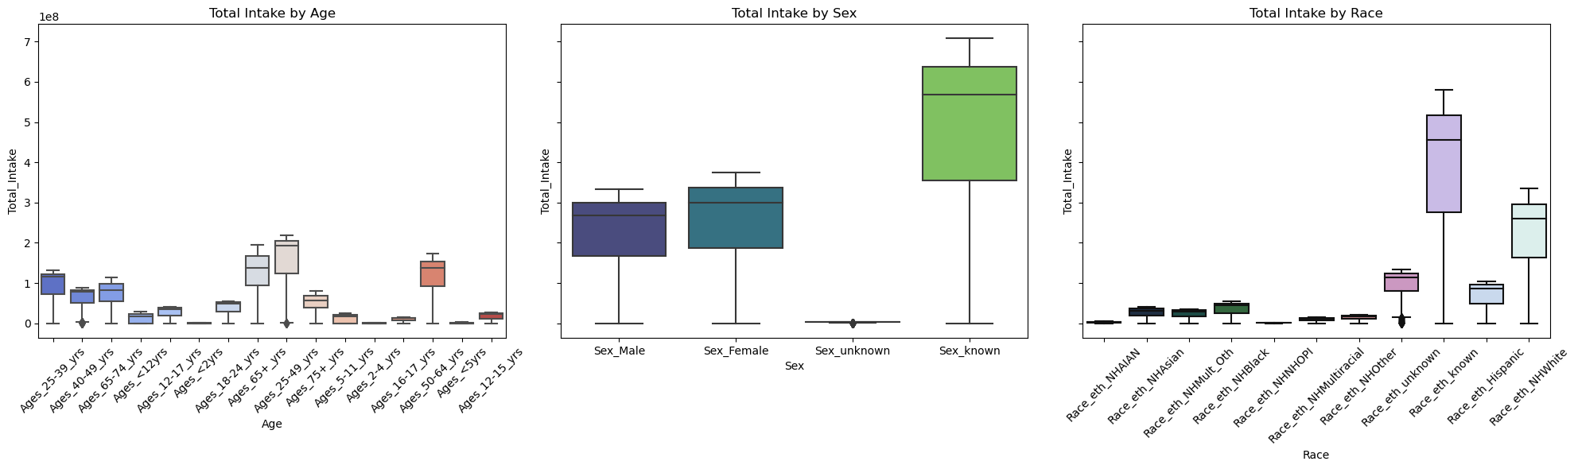
Boxplot Analysis of Total Intake
By Age: The "25-39 years" and "65+ years" groups have higher median intake values, showcasing their significant contribution to vaccine adoption.
Younger age groups, like "<5 years" and "12-17 years," exhibit lower median values and smaller interquartile ranges, consistent with prioritization policies.
By Sex: Males and females have comparable median intake levels, though females show slightly higher consistency.
The "Sex_known" category has the highest spread and median intake.
By Race: Non-Hispanic Whites and the "Race_eth_known" group dominate total intake. Other racial groups show narrower spreads, highlighting disparities in access or participation.

Slide 22
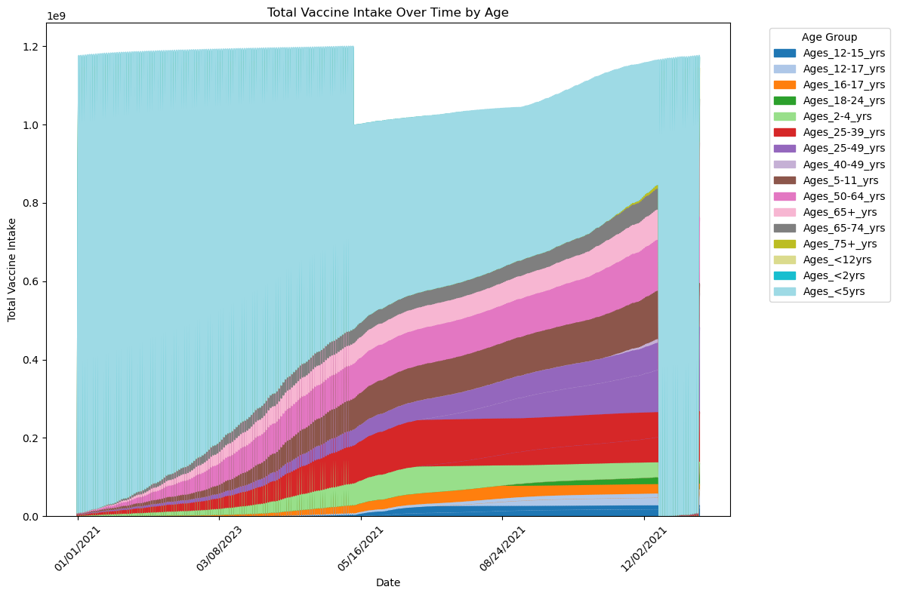
Insights from "Total Vaccine Intake Over Time by Age"
Ages 12-15 years and Ages 12-17 years show a sharp increase, particularly in the middle of 2021. This could correspond to the introduction of vaccines for younger age groups.
Ages 65+ years and Ages 75+ years also have significant vaccination intake, especially early in the pandemic, as older age groups were prioritized for vaccination.
Younger age groups like Ages 2-4 years, Ages <2 years, and Ages <5 years show much smaller increases in total vaccine intake, reflecting a delay in vaccine availability for younger children.

Slide 23
Model Building
Model Used:
Machine Learning Algorithm: Random Forest Regression
Target Variable: Total Vaccination Intake
Features Considered: Demographic categories, including race, age, and sex
Evaluation Metrics:
R-squared: 0.9997
We utilized a Random Forest Regression model to identify the top features influencing vaccination intake. The dataset comprises approximately 30,000 observations, allowing for robust analysis.
These results indicate that the model effectively captures the variance in the data, with a high R-squared value suggesting excellent predictive accuracy.

Slide 24
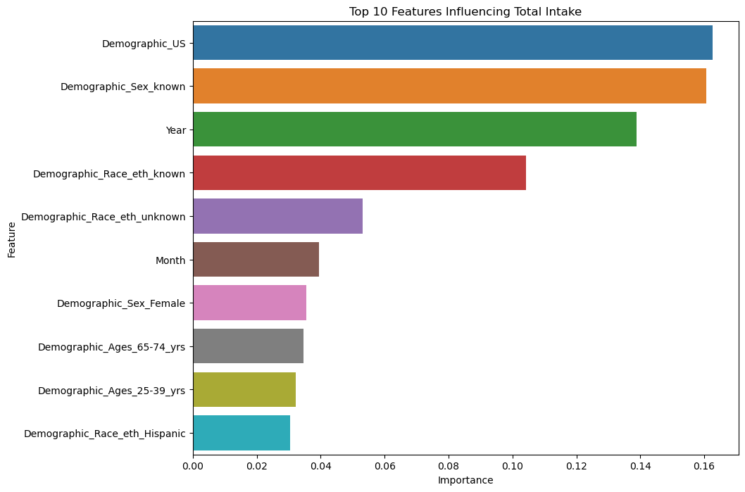
Top Features Impacting Vaccination
Insights from "Top 10 Features Influencing Total Vaccine Intake"
Top Influential Factors: Demographic_US: Regional demographic data significantly impacts vaccine intake, reflecting state-specific policies and infrastructure.
Demographic_Sex_known: Known demographic data, especially sex, improves vaccine targeting and tracking.
Year: The timeline of vaccine rollout highlights the importance of early, consistent vaccination efforts.
Racial/Ethnic Impact: Demographic_Race_eth_known and Demographic_Race_eth_Hispanic are key factors, showing the influence of race/ethnicity on vaccine trends.
Demographic_Race_eth_unknown highlights the need for better demographic data collection.
Temporal Influence: Month: Vaccine intake varies monthly, suggesting that events like public campaigns and policy changes affect rates.
Age Group Contributions: Demographic_Ages_65-74_years and Demographic_Ages_25-39_years play major roles, with the former due to vulnerability and the latter for workforce participation.
Sex-Based Trends: Demographic_Sex_Female is a significant factor, indicating higher female participation in vaccination programs.

Slide 25
Recommendations:
1. Regional Targeting:
Focus efforts on regions identified by "Demographic_US" data where vaccination rates may be lagging.
2. Improve Data Completeness:
Minimize "unknown" demographic data to enhance predictive accuracy and targeting strategies.
3. Leverage Racial/Ethnic Insights:
Address barriers specific to racial/ethnic groups to boost participation, especially for those underrepresented.
4. Monitor Temporal Trends:
Use year and month trends to optimize vaccine campaigns, aligning outreach with high-impact periods.
5. Age and Sex-Specific Strategies:
Develop tailored programs for high-priority age groups (e.g., 65-74 years) and ensure equitable access across genders.
Let me know if you'd like more detailed analyses or recommendations!

Slide 26
Conclusion
In conclusion, understanding demographic trends and regional variations is essential for improving vaccine distribution and targeting. By focusing on key factors such as sex, age, race/ethnicity, and temporal fluctuations, we can design more effective and equitable vaccination strategies. Tailored outreach efforts, better demographic data collection, and alignment with public health events will ensure that vaccines reach all communities, particularly those who are most vulnerable or underserved. A data-driven, targeted approach is crucial for maximizing vaccine uptake and achieving widespread immunity.

Slide 27
Thank you

